Slide 1

Relation-Oriented Architecture
Relation-Oriented Architecture
Functions
Entities
Components
Services
Objects
The Relation between Functions/Data Entities
Relation
The Relation between Objects
The Relation between Services
Traditional Architectures
Haikuan Li, Visiting Professor
CLEBA Group, Delfgauw
The Netherlands

Slide 2
Reference
H. Li, “Relation-Oriented Architecture and Re-Architecting”, Key-note Speech (Video), International Conference on Information Technology and Software Engineering (ITSE2012), Beijing, China, (Dec. 2012).
H. Li, “Software Development of Datafication Intelligence Architecturalization and Intensification (Lecture Notes)” Seminar on Intelligent Software Development at Northwestern Polytechnical University(NPU), Xi’an, China, 2020

Slide 3
Software Data Mining and Unsupervised Machine Learning
for System Re-Architecting
Three-Step Approach
Architecture
Transformation
Old
Architecture
New
Architecture
In genetic engineering, we get gene structure from tissues and implant it back to the tissues.
Architecture
Recovery
Architecture
Implantation
Legacy System
Recovery – Get an architecture from existing system
Transformation – Restructure the old architecture into a new one.
Build In – Build the new architecture back into the existing system
Maintenance – Software Maintenance with the new architecture

Slide 4
Relation-Oriented Software Architecture 面向关系的软件架构
Relation-oriented software architecture is a high level of abstraction of a system, a computable software architecture, which is the theoretical basis for realizing software architecting and re-architecting, especially in the era of the Software Defined and the Internet of Things.
面向关系的软件架构是一种抽象层次较高而可计算的软件架构，是在软件定义与物联网时代实现软件架构与重架构的理论基础。

Slide 5
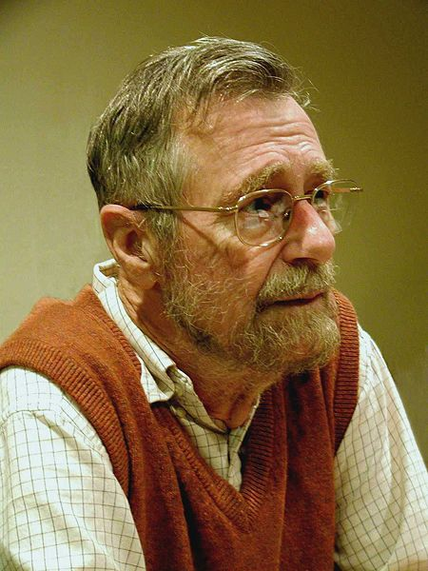
Programming in-the-Large
Logic of a program is a structure composed of similar
sub-structures in a limited number of ways.
Emphasized the importance of the structure style in software development: removing GOTO statement
Provide theoretical foundation and approach for programming-in-the-large, separation of concern
The method of structure programming has actively mastered software industry for a few decades.
Object-orientation introduces another style of software structure.
Service-Oriented Architecture / a new development phase.
Edsger Wybe Dijkstra (Rotterdam, 1930.5.11 –2002.8.6) was een Nederlandse wiskundige en informaticus die veel voor de informatica heeft gedaan, met name op het gebied van gestructureerd programmeren. In 1972 werd hij onderscheiden met de Turing Award.

Slide 6
What is Software Architecture? The issue of SEI /CMU
Architecture serves as the blueprint for both the system and the project developing it, defining the work assignments that must be carried out by design and implementation teams.
The architecture is the primary carrier of system qualities, such as performance, modifiability, and security, none of which can be achieved without a unifying architectural vision.
Architecture is an artifact for early analysis to make sure that the design approach will yield an acceptable system.
Architecture holds the key to postdeployment system
understanding, maintenance, and mining efforts.
In short, architecture is the conceptual glue that holds every phase of the project together for all its many stakeholders.

Slide 7
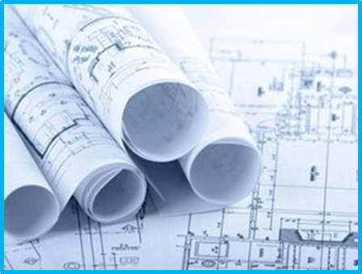
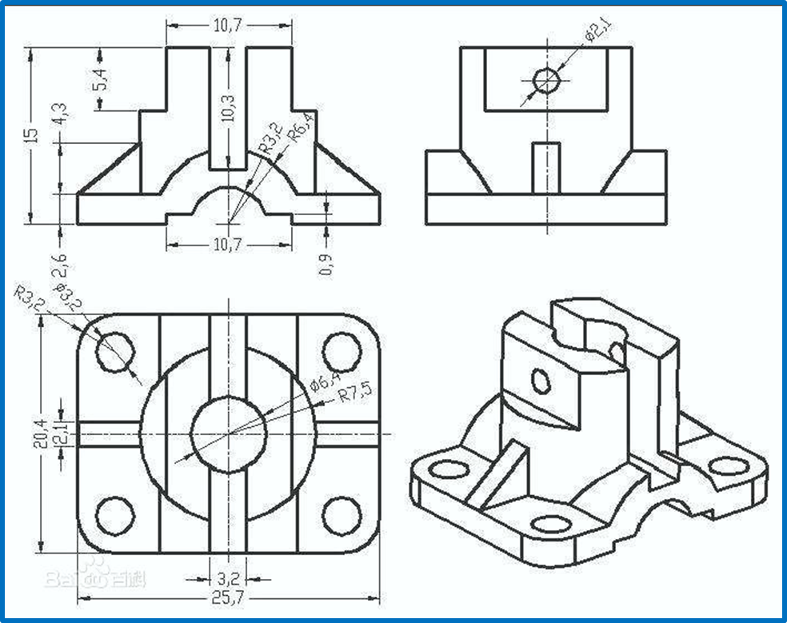
How to Represent Architecture?
A blueprint is a reproduction of a technical drawing, documenting an architecture or an engineering design, using a contact print process on light-sensitive sheets. [wiki]

Slide 8
Software Architecture (System Views)
End-User
Functionality
Developers
Software Management
Logical view: The logical view is concerned with the functionality that the system provides to end-users.
Development view: The development view illustrates a system from a programmer's perspective and is concerned with software management.
Physical view: The physical view depicts the system from a system engineer‘s point of view. It is concerned with the topology of software components on the physical layer as well as the physical connections between these components. This view is also known as the deployment view.
Process view: The process view deals with the dynamic aspects of the system, explains the system processes and how they communicate, and focuses on the runtime behavior of the system. The process view addresses concurrency, distribution, integrators, performance, and scalability, etc.
Scenarios consists of a small set of use cases that describe sequences of interactions between objects and between processes. They are used to identify architectural elements and to illustrate and validate the architecture design. They also serve as a starting point for tests of an architecture prototype. This view is also known as the use case view.
Logical
View
Development
View
Scenarios
Process
View
Physical
View
Integrators
Performance
Scalability
System Engineers
Topological structure
Communication
Kruchten, Philippe, “Architectural Blueprints — The “4+1” View Model of Software Architecture” IEEE Software 12 (6), pp. 42-50, Nov. 1995

Slide 9
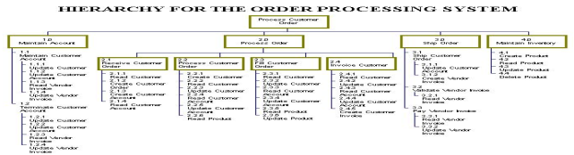
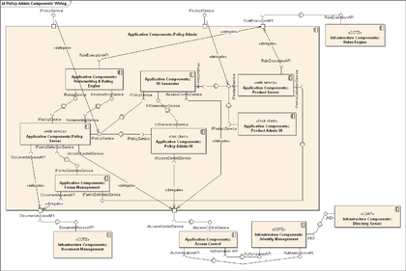
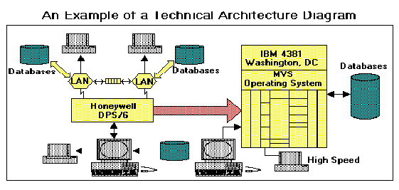
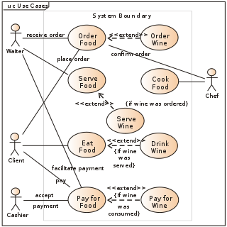
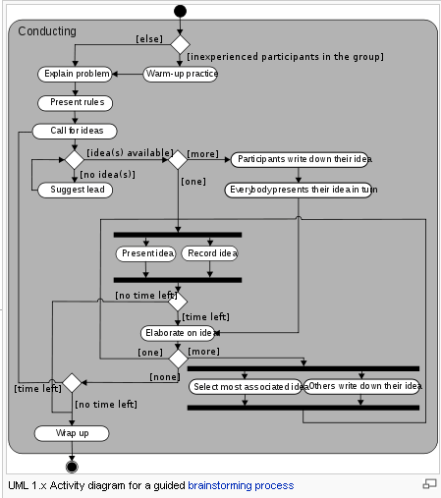
Architecture Views ⎯looking at the same system at abstract level from different corners
Class diagram –Logical view
Component diagram –Development view
Logical view : The logical view is concerned with the functionality that the system provides to end-users. UML Diagrams used to represent the logical view include Class diagram, Communication diagram, Sequence diagram.
Physical view describes the structure and behavior of the technology infrastructure of an enterprise, solution or system
Scenarios : The description of an architecture is illustrated using a small set of use cases.
Development view : The development view illustrates a system from a programmer's perspective and is concerned with software management.
Process view deals with the dynamic aspects of the system, explains the system processes and how they communicate, and focuses on the runtime behavior of the system [Bass 2003]
Infrastructure –Physical view
Use case – Scenarios view
Activity diagram –Process view

Slide 10

Development View
Development view: The development view illustrates a system from a programmer's perspective and is concerned with software management. This view is also known as the implementation view. It uses the UML Component diagram to describe system components. UML Diagrams used to represent the development view include the Package diagram.[2]

Slide 11
Evolution of Architectural Style historical position
FOA (Function-Oriented Architecture)
Stepwise refinement
Different levels of abstraction
OOA (Object-Oriented Architecture)
Object-oriented
Loosely coupled
Class hierarchy for inheritance
SOA (Service-Oriented Architecture)
Service-oriented
Loosely coupled
Different Levels of Abstraction
ROA (Relation-Oriented Architecture)
Function/Object/Service-oriented / Component Based
Loosely coupled
Different Levels of Abstraction

Slide 12
Development View
Development view: The development view illustrates a system from a programmer's perspective and is concerned with software management. This view is also known as the implementation view. It uses the UML Component diagram to describe system components. UML Diagrams used to represent the development view include the Package diagram.[2]

Slide 13
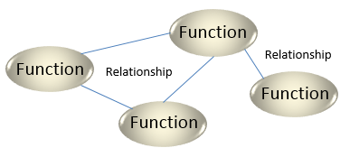
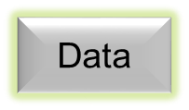
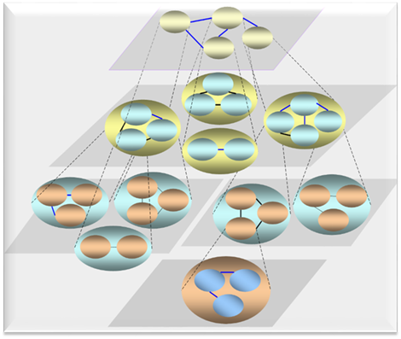
About FOA
Function-Oriented Architecture (FOA) is originated from structure programming, which consists of a set of functional (or data) components and the relationships between them.
Data
Stepwise Refinement is a relatively old technique of software design that has been successfully used in a wide range of structured programming environments and languages.
It is the procedural (step-by-step) form of separation of concerns and has what some may call a fractal nature of task division. [wiki].

Slide 14
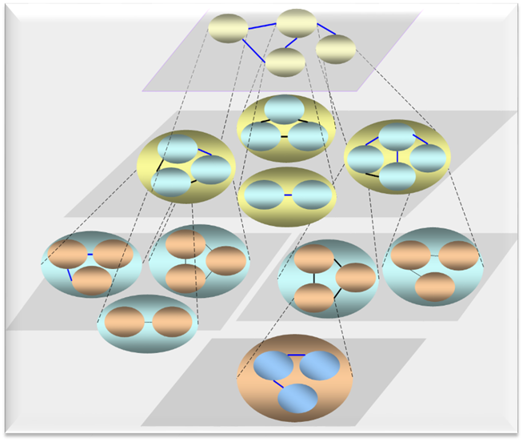
About OOA
Object
Object
Object
Object
Object-Oriented Architecture is originated from object-oriented programming.
Object
Object
Object-oriented programming is a programming paradigm based on the concept of "objects", which may contain data (attributes) and procedures (methods).
From abstract point of view, OOA (Object-Oriented Architecture) consists of a set of objects and the relationships between them.

Slide 15
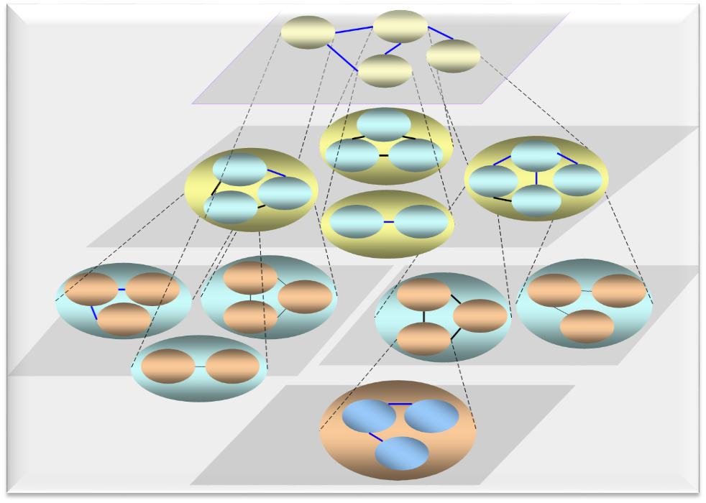
About SOA
A service-oriented architecture is an architectural pattern in software design in which application components provide services to other components via a communications protocol, typically over a network.
The principles of service-orientation are independent of any vendor, product or technology [Msdn.microsoft.com].
Services are loosely coupled units of functionality that are self-contained [wiki]
Service
Service
Service
Service
Service
…
Service
From abstraction point of view, SOA (service-oriented architecture) consists of a set of services and the relationships between them.

Slide 16
An Abstraction of Traditional Architectures
Principles such as simplicity and modularity are the stuff of software engineering; decentralization and tolerance are the life and breath of Internet. -- Tim Berners-Lee， www investor，1998
Keep it simple, stupid! – Tim Berners-Lee，1998
Relation-Oriented Architecture
Functions
Entities
Components
Services
Objects
The Relation between Functions/Data Entities
Relation
Between Components
The Relation between Objects
The Relation between Services
Traditional Architectures

Slide 17
Architecture Space
Relation-Oriented Architecture(ROA) is a kind of architecture with high-level abstraction. It may be considered as an abstraction of Function-Oriented Architecture (FOA), Object-Oriented Architecture(OOA) and Service Oriented Architecture(SOA).
Abstraction
ROA
ROA
ROA
SOA
OOA
FOA
View
Evolution

Slide 18





A system view from another corner
Relation-Oriented (ROA)
Function-Oriented (FOA)
A set of functions(dada) and the
Relationships between them.
Object-Oriented (OOA)
A set of objects and the
Relationships between them.
Service-Oriented (SOA)
A set of Services and the
Relationships between them.
Then we have a new architecture style as follow,
The components and relations are actually “two sides of the same coin”. While all of them are oriented to components, ROA is oriented to relation, catches the commonality of the three traditional architecture styles.
ROA ➔ A set of components and the relationships between them

Slide 19
Relation-Oriented Architecture
<Relation-Oriented Architecture> ::= An organizational Structure of software system, regarding to the relationship between software components at different levels of abstraction
.
Architecture is the organizational structure of a system. An architecture can be recursively decomposed into parts that interact through
relationships that connect parts, and
-- UML 1.3
interfaces,
constraints for
assembling parts.

Slide 20
Properties of ROA
ROA Makes Software Architectures Computable Artifacts
Relation-Oriented (ROA)
A system view from another corner
Higher level abstraction
Commonalities of the existing three.
A computable artifact.
Enabling transformation between different architectural styles
Function-Oriented (FOA)
Object-Oriented (OOA)
Service-Oriented (SOA)
**Our practical experience shown that, because of the computability, automatic architecting and re-architecting are possible.

Slide 21
An Abstraction of Traditional Architectures
Principles such as simplicity and modularity are the stuff of software engineering; decentralization and tolerance are the life and breath of Internet. -- Tim Berners-Lee， www investor，1998
Keep it simple, stupid! – Tim Berners-Lee，1998
Relation-Oriented Architecture
Functions
Entities
Components
Services
Objects
The Relation between Functions/Data Entities
Relation
Between Components
The Relation between Objects
The Relation between Services
Traditional Architectures

Slide 22
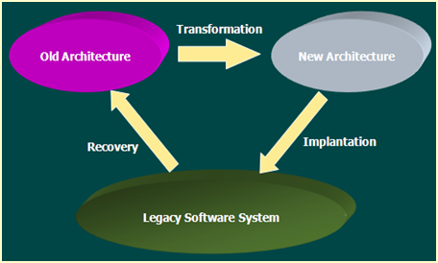

Architecture Recovery
Architecture Recovery is a kind of reverse engineering where in software is as data to be processed.
Software System
in Source Code
Architecture
Recovery
Components +
Relationship
Input
Output
Function-Function (Call/MSG)
Function-Data relation,
Data-Data Relation (ER)
Functions (Components)
Data Entities (Tables)
The Architecture refers to relation-oriented architecture that consists of all components and the relations between them.

Slide 23
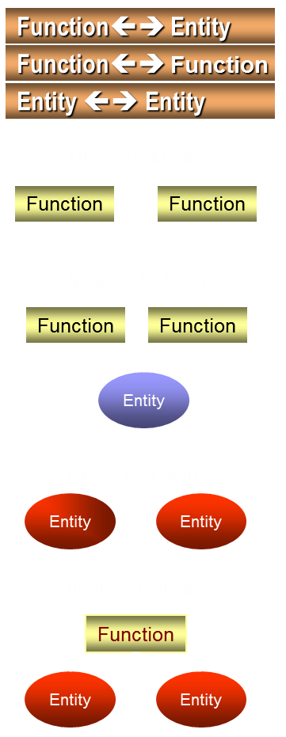
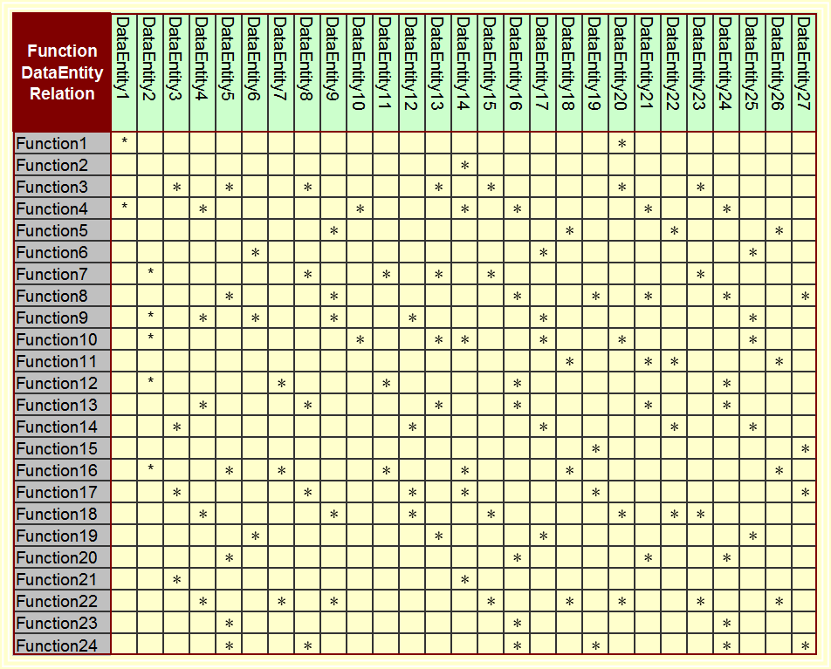
Architecture Recovery Function-Data Relation

Slide 24
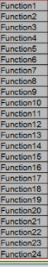
Architecture Recovery: Fun-Fun Matrix
Identify all the functions, including the name and address of each function.
Take the function names to identify the rows of a matrix.
Take the function names to identify the columns of the matrix.
Mark the relationships between the functions and functions.

Slide 25
Architecture Recovery Graphic representation

Slide 26

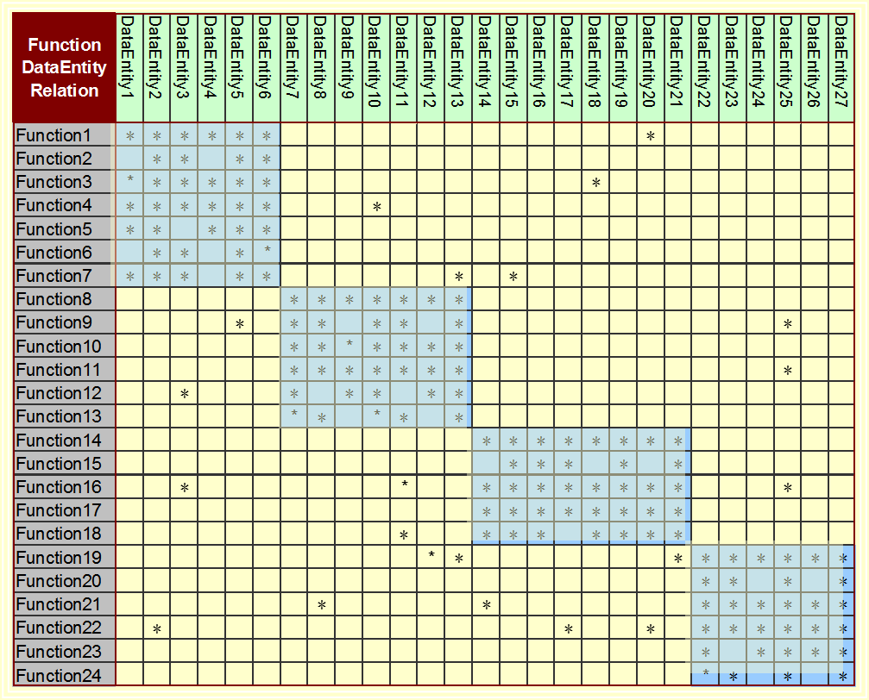
Logical Re-Architecting Relation-Oriented Clustering (Affinity Analysis)

Slide 27
Logical Re-Architecting Graphic Representation

Slide 28
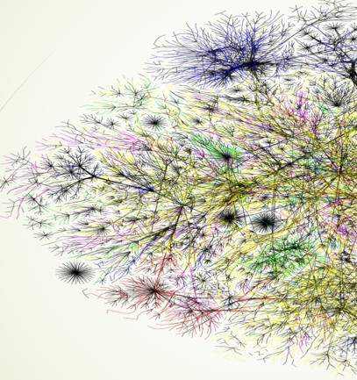
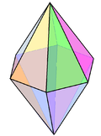
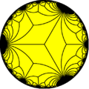
The Potentials of ROA
A computable architecture style such as ROA implies a candidate appraoch to deal with system complexity.
The systems dealing with big data may have additional complexity.
The system's system in internet may be very large and complex.
Emerging internet complexity is increased enormously.
Internet: Connecting all the PCs
Mobile Internet: Connecting all the people
Internet of things：Connecting everything
A new job position for software data mining
As ROA is not only higher-level abstraction but also a computable artifact, an automatic way (as to be discussed later on) is likely to be developed in dealing with the complexity of large and complex systems.

Slide 29
Software Re-architecting
Software Re-architecting is a process to reorganize the organizational structure of the software into a more suitable one.
Physical Re-architecting is a process to reorganize the organizational structure of the software into a more suitable one, without changing the functionality and externally visible behaviors of the software.
Logical Re-architecting is a process to reorganize the organizational structure of the software into a more suitable one, by changing neither functionality , externally visible behaviors nor source code.
The question is, as discussed before, how could we change system architecture without modifying source code?

Slide 30
Software Data Mining and Unsupervised Machine Learning
for System Re-Architecting
Three-Step Approach
Architecture
Transformation
Old
Architecture
New
Architecture
In genetic engineering, we get gene structure from tissues and implant it back to the tissues.
Architecture
Recovery
Architecture
Implantation
Legacy System
Recovery – Get an architecture from existing system
Transformation – Restructure the old architecture into a new one.
Build In – Build the new architecture back into the existing system
Maintenance – Software Maintenance with the new architecture

Slide 31

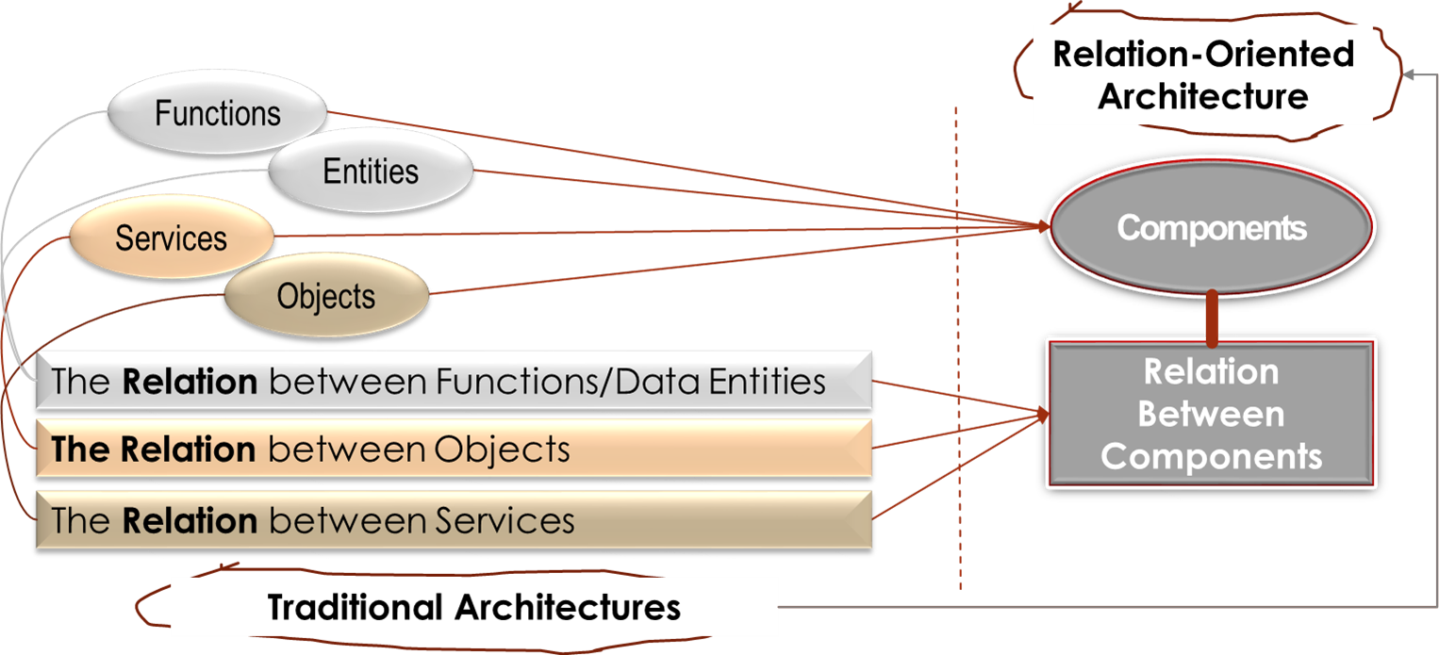
Q&A

Slide 32
A Small Test： Relation-Oriented Architecture
What is software architecture?
What is software system?
Does a single system has one and only one architecture?
Can't you improve system architecture without modifying the system code?
Which three steps are applied to software re-architecting?
What is ROA and why it is useful to deal with system complexity?
How to recover architecture from source code automatically?
What is the difference between logical and physical re-architecting?
Suggest an algorithm for logical re-architecting.
What are the advantages and limitation of logical rearchitecting?

